Slide 1
Placido Bayou 2 year update followed by 5 year alum budget
James Roehm, Service Manager/St. Petersburg

Slide 2
Introduction
Location: Coastal community in N. St. Pete bordering Tampa Bay
Uniqueness:
Continuous flow and connected system
Herbicide restricting DEP permit
Monthly account inspections
History:
Excessive algae, duckweed and hydrilla blooms
Elevated Phosphorous levels
Use of reclaim water
Aeration implemented in all 10 lakes prior to 2013
Yearly standard water analysis since 2012 every October
Alum Treatments
60ppm treatments on ponds 1-8, completed 10/22/13
120ppm treatments on ponds 9-10, completed 5/15/15
60ppm treatments on ponds 6 and 8, completed 3/31/16

Slide 3
Methods I
Performed yearly standard water analysis 10/2014
Proposed alum treatments on ponds 9 and 10 with the highest Phosphate levels
Performed 120ppm alum treatment, May 2015, on pond 9
Performed 120ppm alum treatment, May 2015, on pond 10

Slide 4
Results Ponds 9 and 10: 2015 Alum Treatments

Slide 5
Results Ponds 9 and 10: 2015 Alum Treatments
Reduced weed growth
Yearly phosphate in pond 9 reduces from 1100ppb to 50ppb
Yearly phosphate in pond 10 reduces from 1010ppb to 190ppb
Drawbacks
Phosphorous levels continue to increase over time primarily as a results of reclaimed water
Corrective Action
Continue to monitor total phosphorous and phosphate over time through assessments
Recommend alum treatments when required

Slide 6
Methods II
Performed 2015 standard water analysis
Proposed additional alum treatments on ponds 6 and 8 with the high phosphate levels. These ponds were also beginning to show very large algae blooms again.
Performed 60ppm alum treatment, March 2016, on pond 6
Performed 60ppm alum treatment, March 2016, on pond 8

Slide 8
Results Ponds 6 and 8: 2016 Alum Treatments
-Reduced weed growth
-Total Phosphorous in pond 6 reduced to 1170ppb, approximately the same level of the pond 2 years ago
-Total Phosphorous in pond 8 reduced to 300 ppb, approximately the same level of the pond 3 years ago.
-Drawbacks
-Total Phosphorous is still higher than it was 2 years ago for pond 6
-Corrective Actions
-Propose yearly alum treatments for pond 6

Slide 9
Discussion/Conclusion
Outcomes
Reduced algae and duckweed
Happier Customers
Reduced herbicide use
Final thoughts
How do we budget for the next 5 years to come.

Slide 10
Discussion/Conclusion

Slide 11
Discussion/Conclusion

Slide 12
Discussion/Conclusion
Pond 4: influx of total P by 180ppb per year (alum every 2.2 years)
Pond 5: influx of total P by 150ppb per year (alum every 2.7 years)
Pond 6: influx of total P by 590ppb per year (yearly alum treatments)
Pond 7: influx of total P by 100ppb per year (alum every 4 years)
Pond 8: influx of total P by 200ppb per year (alum every 2 years)
Pond 4: 87% reduction of total P with 60ppm alum treatment
Pond 5: 79% reduction of total P with 60ppm alum treatment
Pond 6: 89% reduction of total P with 60ppm alum treatment
Pond 7: 73% reduction of total P with 60ppm alum treatment
Pond 8: 83% reduction of total P with 60ppm alum treatment
*Based upon alum treatments at a 500ppb threshold

Slide 13
Discussion/Conclusion
Pond 4: influx of total P by 180ppb per year (alum every 4.4 years)
Pond 5: influx of total P by 150ppb per year (alum every 5.3 years)
Pond 6: influx of total P by 590ppb per year (alum every 1.4 years)
Pond 7: influx of total P by 100ppb per year (alum every 8 years)
Pond 8: influx of total P by 200ppb per year (alum every 4 years)
Pond 4: 87% reduction of total P with 60ppm alum treatment
Pond 5: 79% reduction of total P with 60ppm alum treatment
Pond 6: 89% reduction of total P with 60ppm alum treatment
Pond 7: 73% reduction of total P with 60ppm alum treatment
Pond 8: 83% reduction of total P with 60ppm alum treatment
*Based upon alum treatments at a 1,000ppb threshold

Slide 14
Discussion/Conclusion
Most recent TP readings:
Site 4: 780 TP
Site 5: 790 TP
Site 6: 1170 TP
Site 7: 680 TP
Site 8: 300 TP
Sites 4, 5, 6 and 7 require an alum treatment soon…

Slide 15
Discussion/Conclusion
What about ponds 1, 2, 3, 9 and 10?
Placido Bayou has received alum in all ponds. A.S.I. took more regular readings on 4, 5, 6, 7, and 8 at our expense because the symptoms were most severe; this is how we were able to determine Phosphorous rebound.
Based on problematic algae problems and yearly water chemistries, A.S.I recommends treating ponds 2 and 3 with next large scale alum treatment while continuing yearly water chemistries and switching October chemistries to include total phosphorous.
A.S.I recommends postponing use of alum in ponds 1, 9 and 10 until evidence of reoccurring problematic algae appears.

Slide 16
Standard Lake Assessments Recommended
-Water column dissolved oxygen profile
-Temperature
-Depth
-Secchi
-Surface Total Phosphorous
-Bottom Total Phosphorous
-Surface Nitrogen
-Bottom Nitrogen
-Surface Ammonia
-Bottom Ammonia
This recommended package is not currently performed, but offers PBCA a deeper scientific assessment on the ecology of the ponds. We can better read nutrient loads as well as assess proper aeration. Cost is approximately $2,920. This can replace previous water chemistries that cost $1,200.

Slide 17
Discussion/Conclusion

Slide 18
Discussion/Conclusion
Deciding threshold: 500ppb or 1,000ppb
Initial TP:
Site 4) 1730
Site 5) 1590
Site 6) 2950
Site 7) 1450
Site 8)1430
Symptoms with these nutrient loads
Site 4) overwhelming algae and reoccurring duckweed
Site 5) reoccurring algae and reoccurring duckweed
Site 6) overwhelming algae and platonic algae
Site 7) overwhelming duckweed and algae
Site 8) overwhelming duckweed and algae

Slide 19
Costs: 500ppb Threshold
2016: no treatments
2017: alum ponds 2, 3, 4, 5, 6, 7
2018: alum pond 6
2019: alum ponds 4, 8, 6
2020: alum pond 6
2021: alum ponds 7, 5, 6, 2, 3, 4, 8

Slide 20
Costs: 1,000ppb Threshold
2016: no treatments
2017: alum pond 6
2018: alum pond 2, 3, 4, 5, 6, 7
2019: alum pond 6
2020: alum pond 6
2021: alum ponds 6
2022: alum ponds 4, 5,6, 8

Slide 21
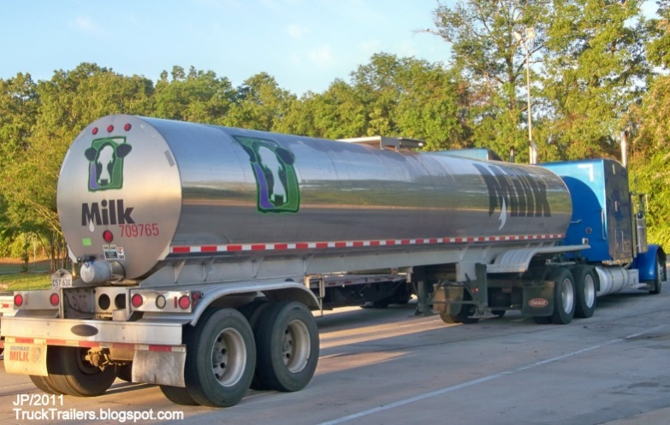
Cost Considerations
-Due to the large volume of alum and transportation difficulties, it is most cost effective to treat many ponds at the same time with tanker transportation.
-Alum works best in warm weather.

Slide 22
Dredging?
-ASI recommends a bathymetric mapping to occur on all of the ponds. The cost is $500 per surface acre.
-At 23.18 acres, the cost to map all ponds is $11,590

Slide 23
Mapping Before Dredging
-Bathymetric mapping will give a baseline on each retention pond’s storm water capacity. This information is necessary to help determine the muck levels in each pond. Some retention ponds require dredging at some point, the question is when?
-Mapping can be used later to determine if and where core samples should be taken.

Slide 24
Core Samples
-Bathymetric mapping will help ASI determine useful areas for coring. Coring can be done to the maximum of about 17ft deep. Cores will show exactly how much muck has accumulated in that area.
-Core samples in one area of the lake can show completely different amounts of muck than core samples in different areas. This means numerous core samples per lake are usually taken.
-Coring will be recommended based on the results of bathymetric mapping.

Slide 25
Mapping in 5 Years
-Updated bathymetric mapping 5 years down the road will help build information on how the bottom of the lake is changing. This information is vital and will determine how fast the muck is accumulating.

Slide 26
Dredging? Aeration? Bathymetry
-When a pond is properly aerated, studies have shown muck accumulation slows down. As time passes, additional aeration may be needed.
-Recommended “Standard Lake Assessments” will help monitor the lakes to ensure they are receiving proper aeration.
-Bathymetric mapping will help assess aeration’s ability to slow muck accumulation at Placido Bayou.

Slide 27
Conclusions
-Bathymetric mapping will give a baseline of the retention pond’s storm water capacity and can help provide the community insight on possible dredging costs.
-Follow up bathymetric mapping could show 2 main results:
1) The pond is accumulating muck at X rate. Dredging will be necessary sometime in the future.
2) The pond is accumulating minimal muck and dredging may not be needed.

Slide 28
Questions?

